Slide 1
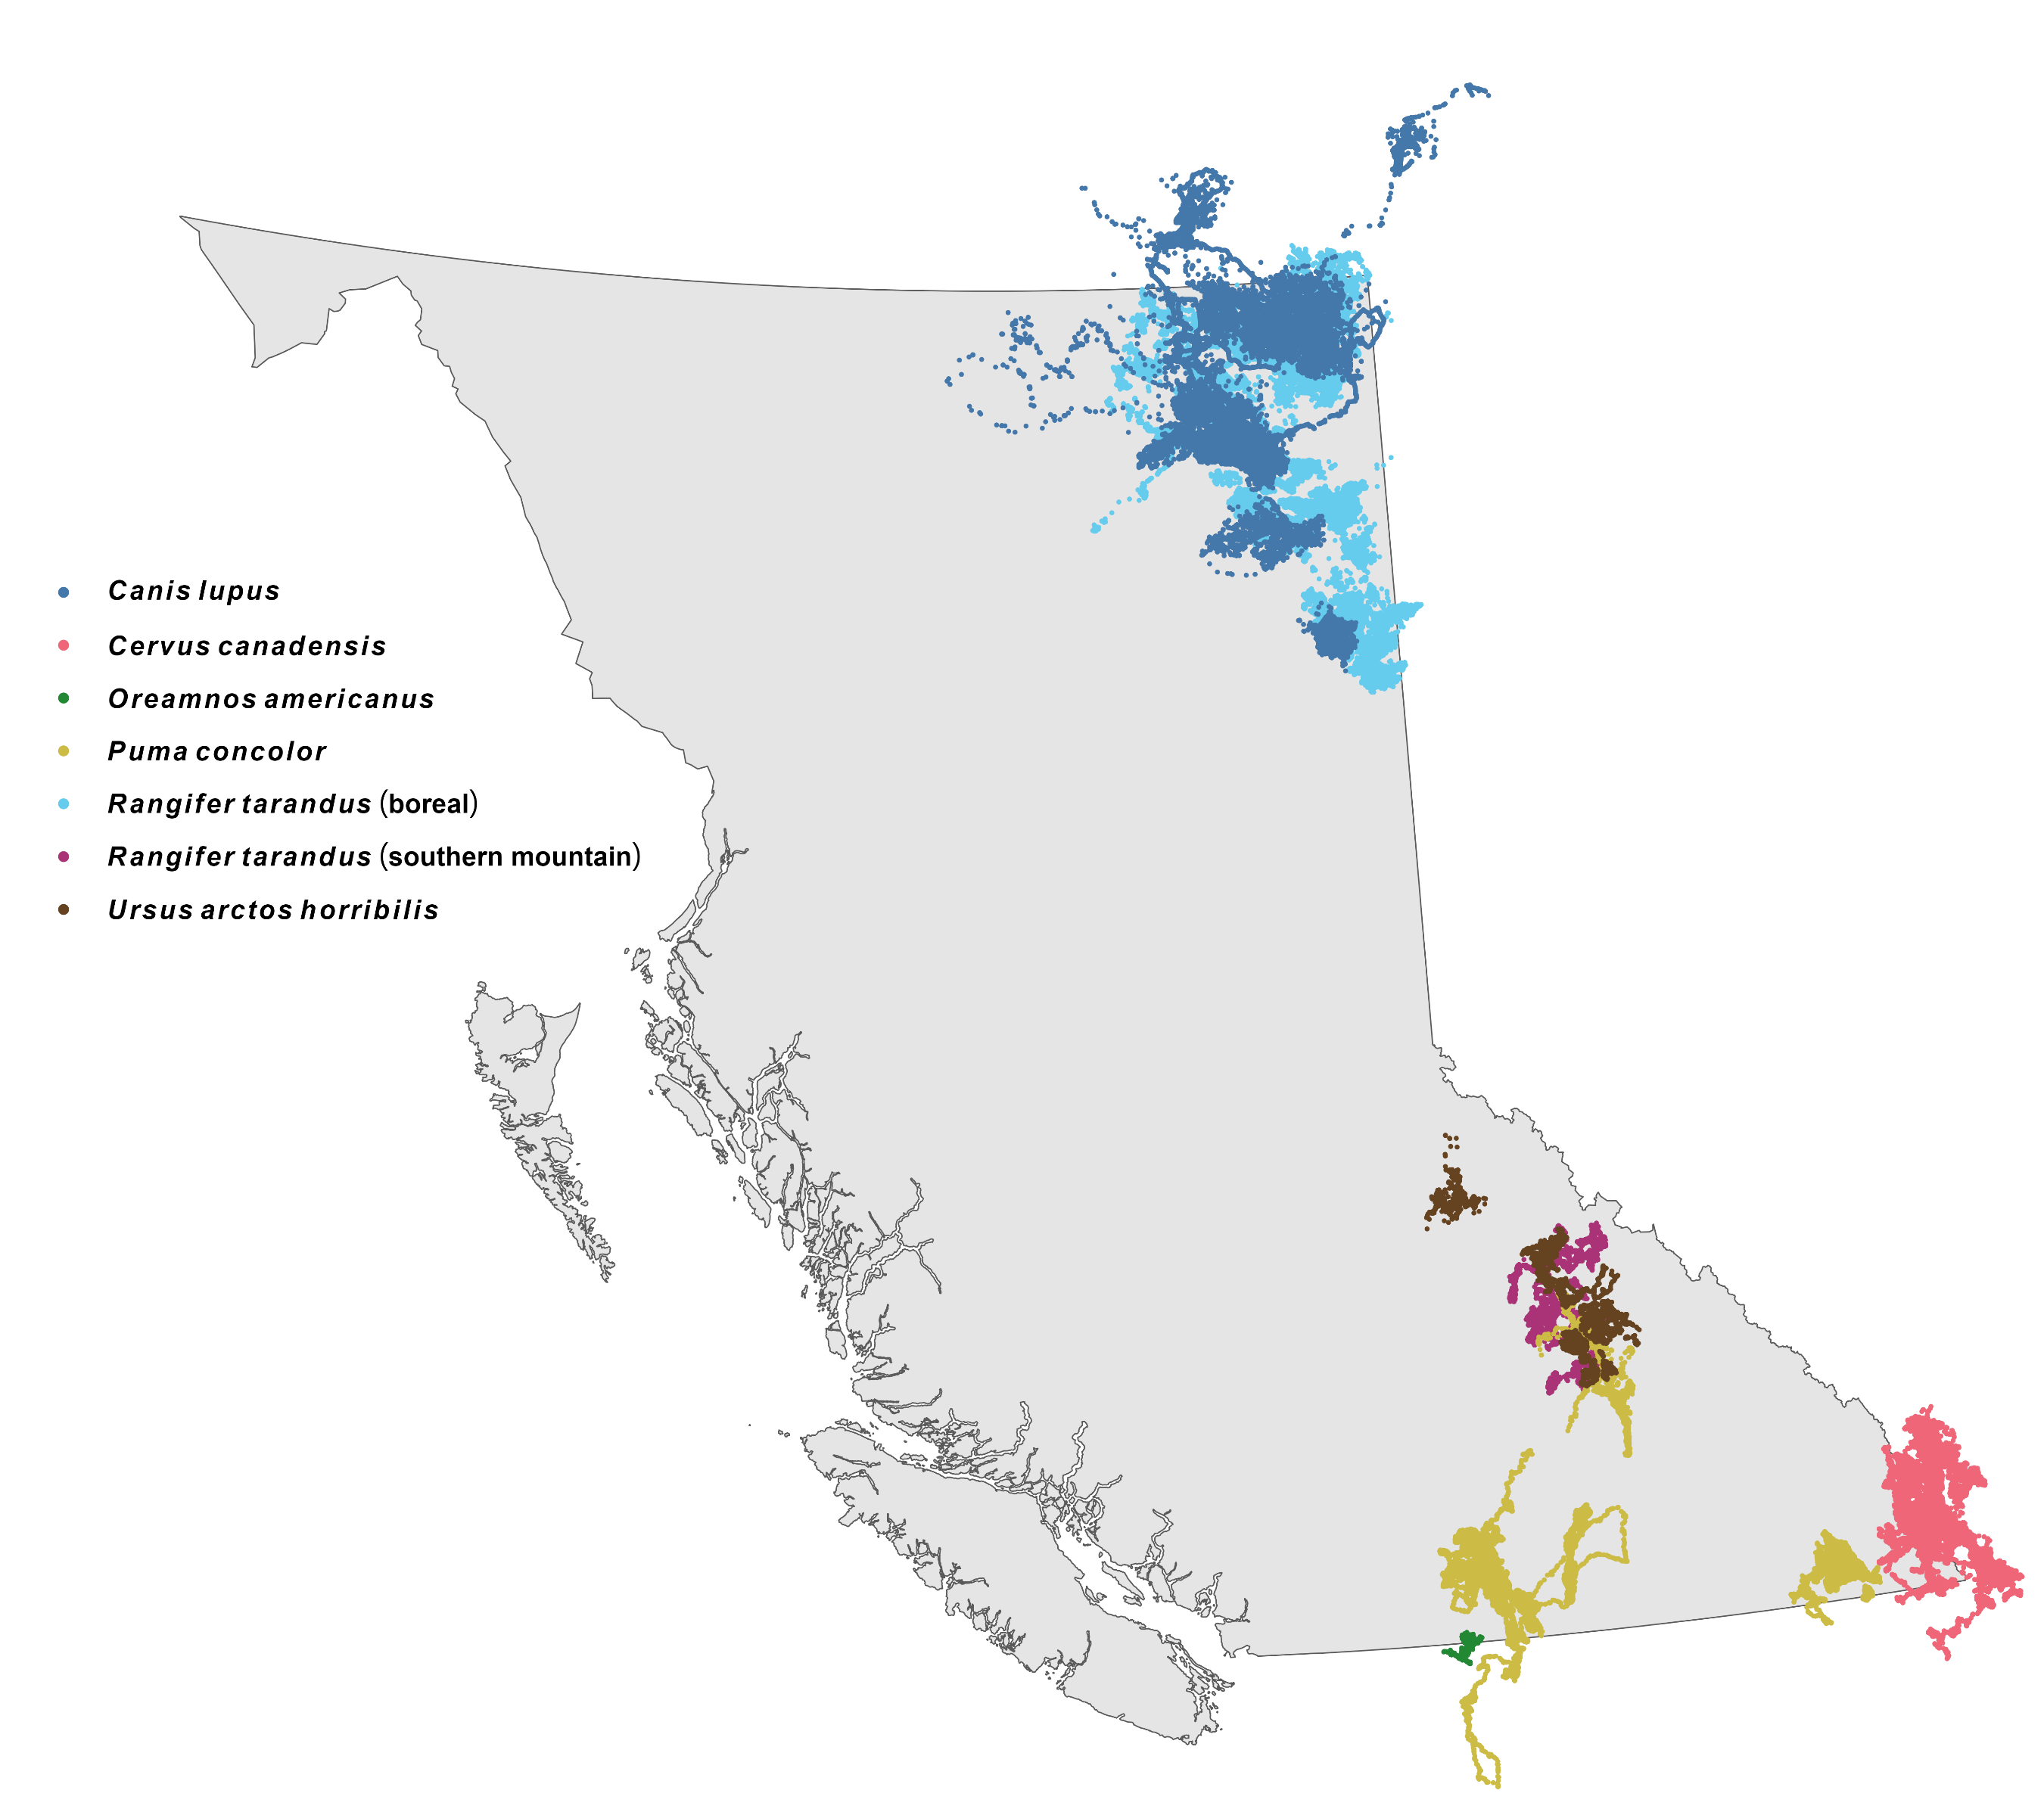

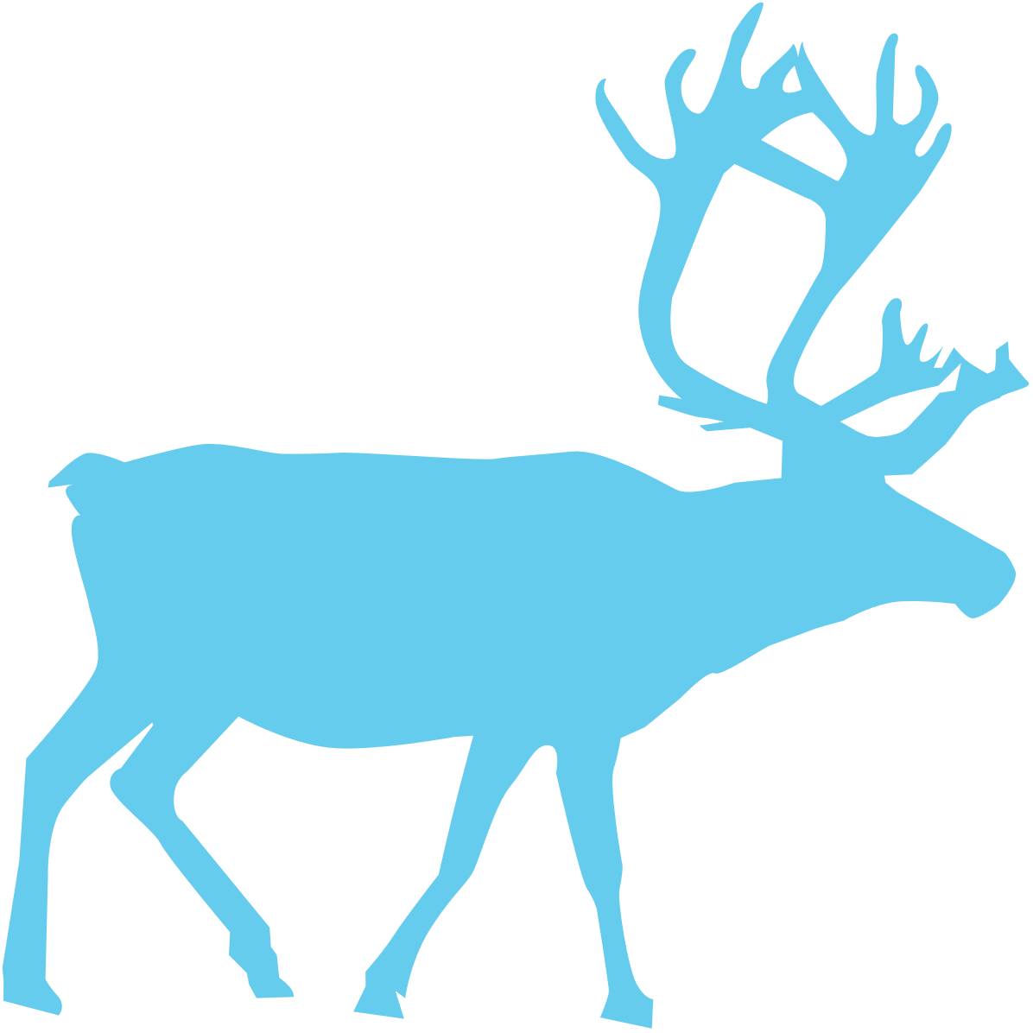





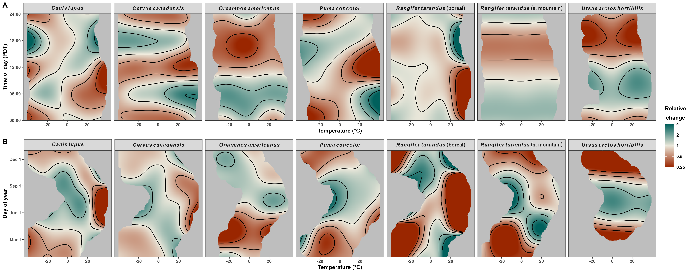
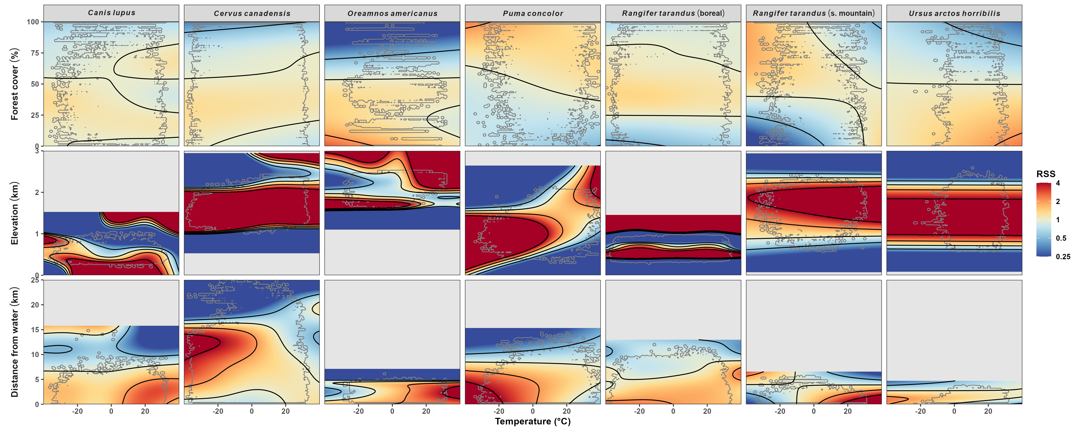
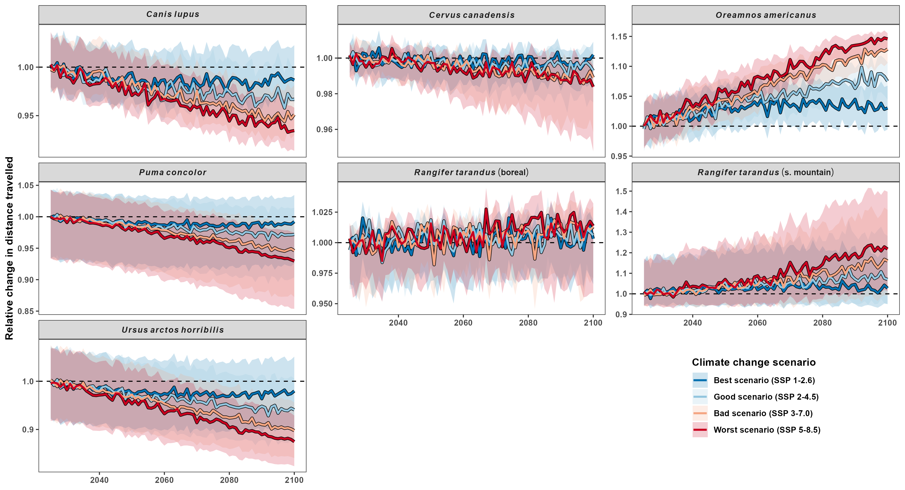
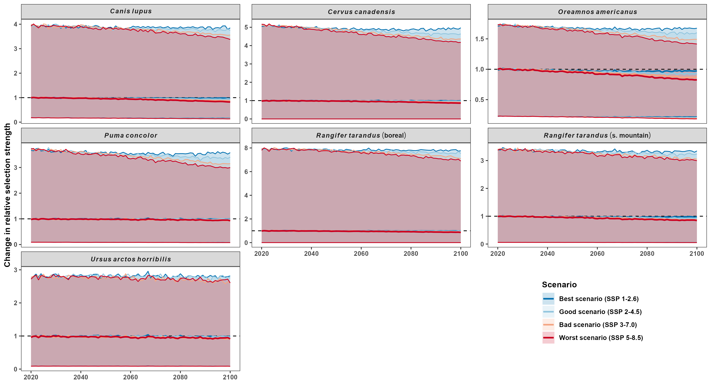





How does temperature affect how and where mammals move?
Stefano Mezzini^{1, 2}, Chris H. Fleming^{3, 4}, Siobhan Darlington^{1, 2}, Adam T. Ford^{1, 2}, Karen E. Hodges^{1, 2}, Kirk Safford⁵, Robert Serrouya,^{1, 2, 6}, Michael J. Noonan^{1, 2, 7}
(1) Okanagan Institute for Biodiversity, Resilience, and Ecosystem Services, The University of British Columbia Okanagan, Kelowna, British Columbia, Canada. (2) Department of Biology, The University of British Columbia Okanagan, Kelowna, British Columbia, Canada.
(3) Department of Biology, University of Central Florida, Orlando, Florida 32816, United States. (4) Smithsonian Conservation Biology Institute, National Zoological Park, Front Royal, Virginia 22630, United States. (5) BC Parks.
(6) Wildlife Science Centre, Biodiversity Pathways, University of British Columbia Okanagan, Revelstoke, British Columbia, Canada. (7) Department of Computer Science, Math, Physics, and Statistics, The University of British Columbia Okanagan, Kelowna, British Columbia, Canada.
Significance and central findings
Climate change is rapidly altering the landscapes mammals live in. We quantified how temperature affects mammals’ movement behavior to predict how and where mammals will move in the 21st century. We found that although some species move to higher elevations to escape the heat, temperature affects each species differently, so conservation-based decisions should be made on a species-level basis.
Background
Temperature affects mammals’ movement costs, physiology, and offspring survival.
Climate change has caused many mammals to change when, how, and where they move
These change have had cascading effects on individuals’ fitness and habitat selection
How do we predict how climate change will affect BC mammals by the end of the century?
Methods
Telemetry data from 7 species (Fig. 1)
Estimated speed using ctmm package¹ for R
Fit Hierarchical Generalized Additive to estimate:
Effects of temperature on P(moving) and speed
Habitat selection using Hierarchical Resource Selection Functions^{2,3}.
Fig. 1. Telemetry data of the 7 species used. From top to bottom: boreal wolves (Canis lupus), boreal and southern mountain caribou (Rangifer tarandus), grizzly bears (Ursus arctos horribilis), elk (Cervus canadensis), mountain goat (Oreamnos americanus), and cougars (Puma concolor).
Some species will move more, others less
All species adapted their daily or seasonal movement behavior in response to changes in temperature, but each species responded differently (Fig. 2).
Fig. 2. Relative effects of temperature on species’ daily and seasonal trends in distance traveled.
Green indicates 4 times more movement than the overall mean, while red indicates four 4 times less movement.
Climate change will affect each species’ movement differently. Some will move more; others will move less (Fig. 3). S. mountain caribou are predicted to respond the most.
Fig. 3. Predicted change in mean distance travelled throughout the 21st century, under different climate change scenarios. Lines indicate the median change; ribbons are the 90% range of predicted mean changes.
Each species will prefer different habitats
All species adapted their habitat selection in response to changes in temperature, but each species responded differently (Fig. 4). 5 of 7 move along elevational gradients.
Fig. 4. Each species’ relative selection strength (RSS) for forest cover, elevation, and distance from water.
Values are capped at 4 times weaker or stronger RSS for ease of readability.
Under the worst-case scenario, 6 of 7 species will select less strongly for the top 5% of habitat in the current range. There is little to no change in the best-case scenario.
Fig. 5. Predicted change in relative habitat selection strength for each species’ observed population ranges.
Lines are the 95th, 50th, and 5th percentiles in relative selection strength for the current range.
References
Noonan M.J., Fleming C.H., Akre T.S., Drescher-Lehman J., Gurarie E., Harrison A.-L., et al. (2019). Scale-insensitive estimation of speed and distance traveled from animal tracking data. Movement Ecology 7, 35. https://doi.org/10.1186/s40462-019-0177-1
Alston J.M., Fleming C.H., Kays R., Streicher J.P., Downs C.T., Ramesh T., et al. (2022). Mitigating pseudoreplication and bias in resource selection functions with autocorrelation‐informed weighting. Methods in Ecology and Evolution, 2041–210X.14025. https://doi.org/10.1111/2041-210X.14025
McCabe J.D., Clare J.D., Miller T.A., Katzner T.E., Cooper J., Somershoe S., et al. (2021). Resource selection functions based on hierarchical generalized additive models provide new insights into individual animal variation and species distributions. Ecography 44, 1756–1768. https://doi.org/10.1111/ecog.06058
Cougar phylopic: CC BY-NC 3.0: Cristian Osorio & Paula Carrera, Proyecto Carnivoros Australes
Mountain goat phylopic: CC-BY-SA 3.0: Sarah E. Haworth
Funder acknowledgements

